Slide 2
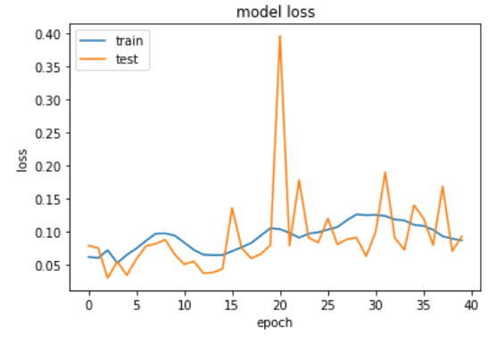
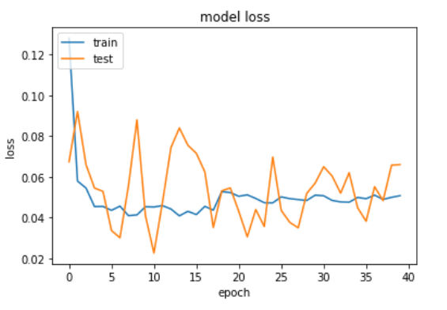
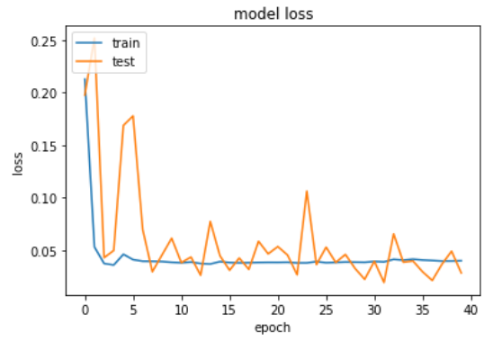
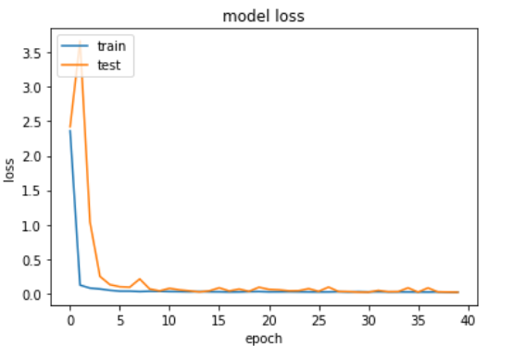
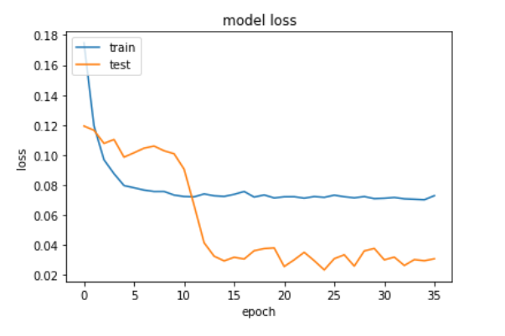
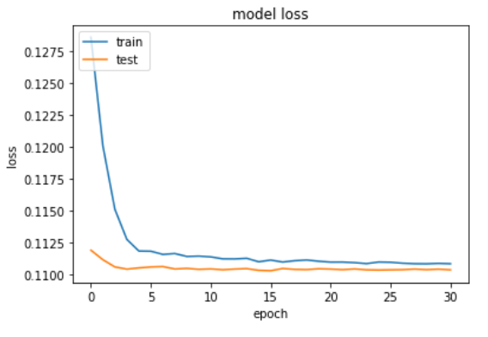
Without batch normalization
40 epochs
Batch_size = 10
Time per epoch = 47s
With batch normalization
40 epochs
Batch_size = 40
Time per epoch = 22s
With batch normalization
40 epochs
Batch_size = 128
Time per epoch = 8s
With batch normalization
40 epochs
Batch_size = 512
Time per epoch = 2s
With batch normalization
& dropout (0.2)
40 epochs
Batch_size = 512
Time per epoch = 2.5s

Slide 3
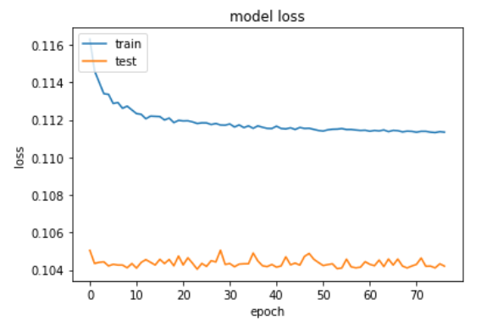
Node 64
Hidden 3
Batch 256

